Slide 1
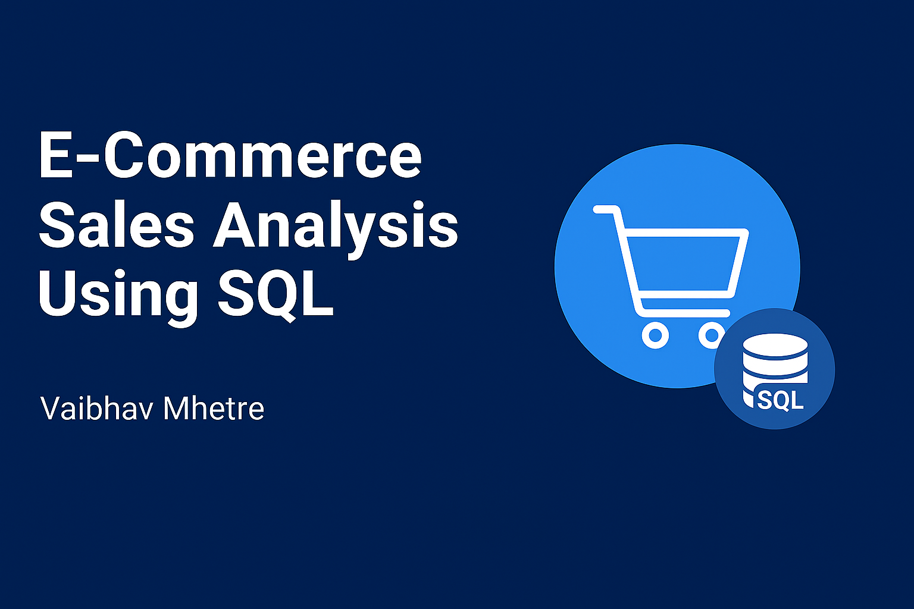


mhetrevaibhav5@gmail.com
Vaibhav Mhetre

Slide 2

🎯 Project Aim
The main aim of this project is to analyze e-commerce sales data using SQL to uncover meaningful insights into customer behavior, sales performance, product demand, and revenue trends.
By leveraging SQL queries, this project aims to improve understanding of business operations and support data-driven decision-making in areas like marketing, sales forecasting, and customer retention.

Slide 3
📘 Project Objectives
1) Data Preparation: Understand the e-commerce dataset, clean it, and load it into a relational
database.
2) Sales Insights: Analyze customer locations, order volumes, and category-wise sales.
3) Business Analysis: Track monthly trends, product performance, and top sellers.
4) Advanced Insights: Examine spending patterns, retention rates, and yearly growth.
Decision Support: Convert SQL findings into actionable recommendations for marketing,
sales, and inventory optimization.

Slide 4
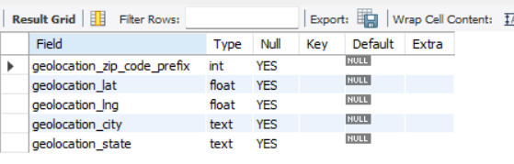
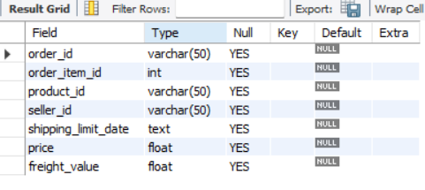
Table Description
Table geolocation :
Table order_items :

Slide 5
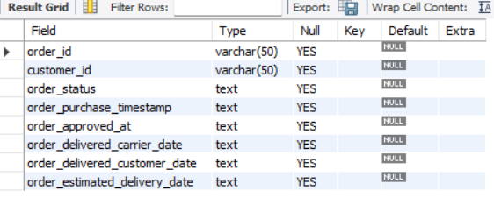
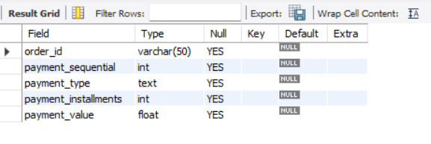
Table Description
Table orders :
Table payments :

Slide 6
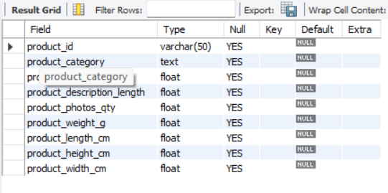
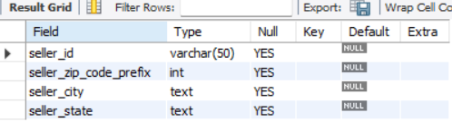
Table Description
Table products :
Table sellers :

Slide 7
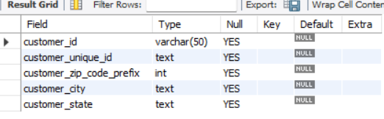
Table Description
Table customers :

Slide 8
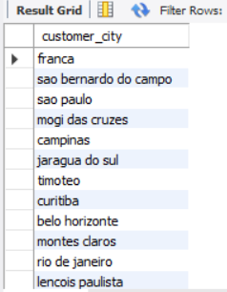
Basic To Advance Queries
1. List all unique cities where customers are located.
Ans :
Select distinct (customer_city) from customers;
Outputs :

Slide 9

2. Count the number of orders placed in 2017.
Ans :
Select count(order_id) as Total_Orders_In_2017
from orders
where year(order_purchase_timestamp) = 2017;
Outputs :

Slide 10
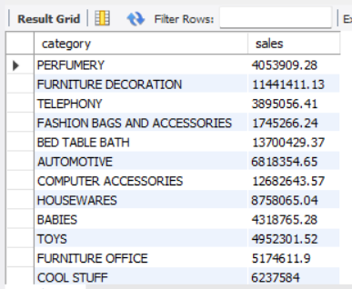
3. Find the total sales per category.
Ans :
Outputs :
Select upper(products.product_category) As category,
round(sum(payments.payment_value),2) sales
from products join order_items
on products.product_id = order_items.product_id
join payments
on payments.order_id = order_items.order_id
group by category;

Slide 11

4. Calculate the percentage of orders that were paid in installments.
Ans :
Outputs :
Select (sum(case when payment_installments >= 1 then 1 else 0 end))/count(*)*100 as percentage_Paid_By_Installments from payments ;

Slide 12
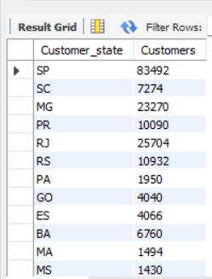
5. Count the number of customers from each state.
Ans :
Outputs :
select distinct Customer_state,count(customer_id)
as Customers
from customers
group by customer_state ;

Slide 13
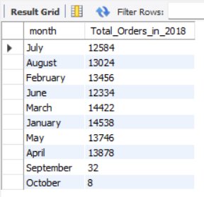
6. Calculate the number of orders per month in 2018.
Ans :
Outputs :
select monthname(order_purchase_timestamp) month, count(order_id) as Total_Orders_in_2018
from orders
where year(order_purchase_timestamp) = 2018
group by month;

Slide 14
7. Find the average number of products per order, grouped by customer city.
Ans :
with count_per_order as
(select orders.order_id,orders.customer_id ,count(order_items.order_id) as oc
from orders join order_items on orders.order_id = order_items.order_id
group by orders.order_id,orders.customer_id)
select customers.customer_city,round(avg(count_per_order.oc),2) as average_orders
from customers
join count_per_order
on customers.customer_id = count_per_order.customer_id
group by customers.customer_city
order by average_orders desc;
Outputs :

Slide 15
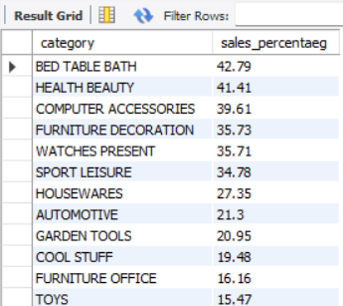
8. Calculate the percentage of total revenue contributed by each product category.
Ans :
select upper( products.product_category) as category, round((sum(payments.payment_value)/(select sum(payment_value) from payments)) * 100,2) as sales_percentaeg
from order_items join products
on order_items.product_id = products.product_id
join payments
on payments.order_id = order_items.order_id
group by category
order by sales_percentaeg desc;
Outputs :

Slide 16
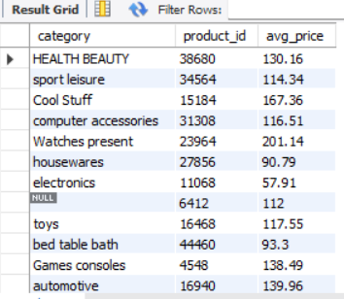
9. Identify the correlation between product price and the number of times a product has been purchased.
Ans :
Outputs :
select products.product_category as category , count(order_items.product_id) as product_id, round(avg(order_items.price),2) as avg_pricefrom products join order_items
on products.product_id = order_items.product_id
group by category;

Slide 17
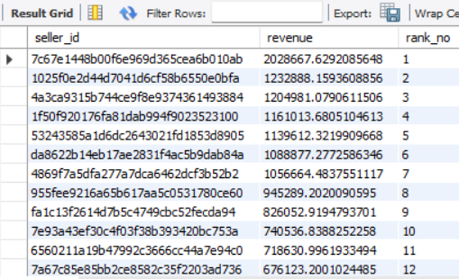
10. Calculate the total revenue generated by each seller, and rank them by revenue.
Ans :
Outputs :
select * ,dense_rank() over(order by revenue desc)
as rank_no
From
(select order_items.seller_id,
sum(payments.payment_value) revenue
from order_items join payments
on order_items.order_id = payments.order_id
group by order_items.seller_id) as a;

Slide 18
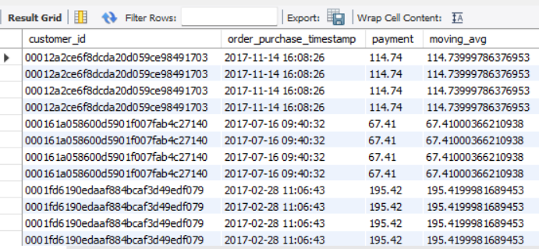
11. Calculate the moving average of order values for each customer over their order history.
Ans :
select customer_id,order_purchase_timestamp,payment,avg(payment)over (partition by orders.customer_id
order by order_purchase_timestamprows between 2 preceding and current row)
as moving_avg
from
Outputs :
(select
orders.customer_id,orders.order_purchase_timestamp,payments.payment_value as payment
from orders
join payments
on orders.order_id = payments.order_id) as a;

Slide 19
12. Calculate the cumulative sales per month for each year.
Ans :
Outputs :
select years, months, payment, sum(payment)over(order by years , months) cumulative_sales
From
(select year(orders.order_purchase_timestamp) as years,
month(orders.order_purchase_timestamp) as months, round(sum(payments.payment_value),2) as payment from orders join payments
on orders.order_id = payments.payment_valuegroup by years , months order by years , months) as a;

Slide 20
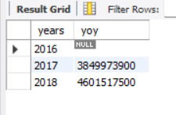
13. Calculate the year-over-year growth rate of total sales;
Ans :
with a as
(select year(orders.order_purchase_timestamp) as years, round(sum(payments.payment_value),2)
as payment
from orders
join payments
on orders.order_id = payments.payment_value
group by years order by years )
select years,(payment-lag(payment) over (order by years)/lag(payment,1) over (order by years))*100 as yoy from a;
Outputs :

Slide 21
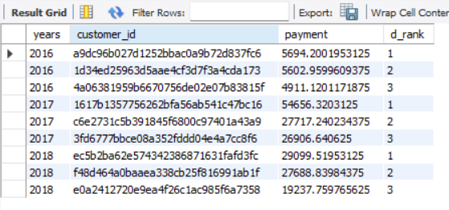
14. Identify the top 3 customers who spent the most money in each year.
Ans :
Select years, customer_id, payment, d_rank
From
(select year(orders.order_purchase_timestamp) years,orders.customer_id,sum(payments.payment_value) as payment,dense_rank() over(partition by year(orders.order_purchase_timestamp) order by sum(payments.payment_value) desc) d_rank
from orders join payments
on payments.order_id = orders.order_id
group by year(orders.order_purchase_timestamp),
orders.customer_id ) as a where d_rank <=3 ;
Outputs :

Slide 22
🏁 Conclusion
This SQL-based e-commerce sales analysis project successfully demonstrates how structured data can be transformed into actionable business intelligence using SQL.
Through basic, intermediate, and advanced queries, the project reveals patterns in customer purchasing behavior, product performance, and revenue trends.
Key findings include:
The identification of top-performing product categories and high-revenue sellers.
Seasonal and monthly order fluctuations providing insight into demand cycles.
Evidence of customer retention and spending patterns that support marketing strategies.
Overall, the project highlights SQL’s strength in exploring, analyzing, and interpreting large datasets, proving its essential role in business analytics and decision-making.

